Slide 1
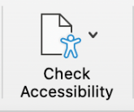
It is our responsibility to ensure presentations are accessible for all.
Follow these simple steps to ensure your PPT presentations are accessible:
Use a minimum font size of 24 pt.
Click on the built-in “Check Accessibility” button under the Review tab to solve any accessibility errors/warnings
Ensure the reading order is accessible
Set up your Slide Titles
Add in Alt text to photos, graphics, icons, and charts
Make tables accessible

